Slide 1
KnowledgeAI Architecture
Breakthrough Engineering for the Digital Enterprise

Slide 2
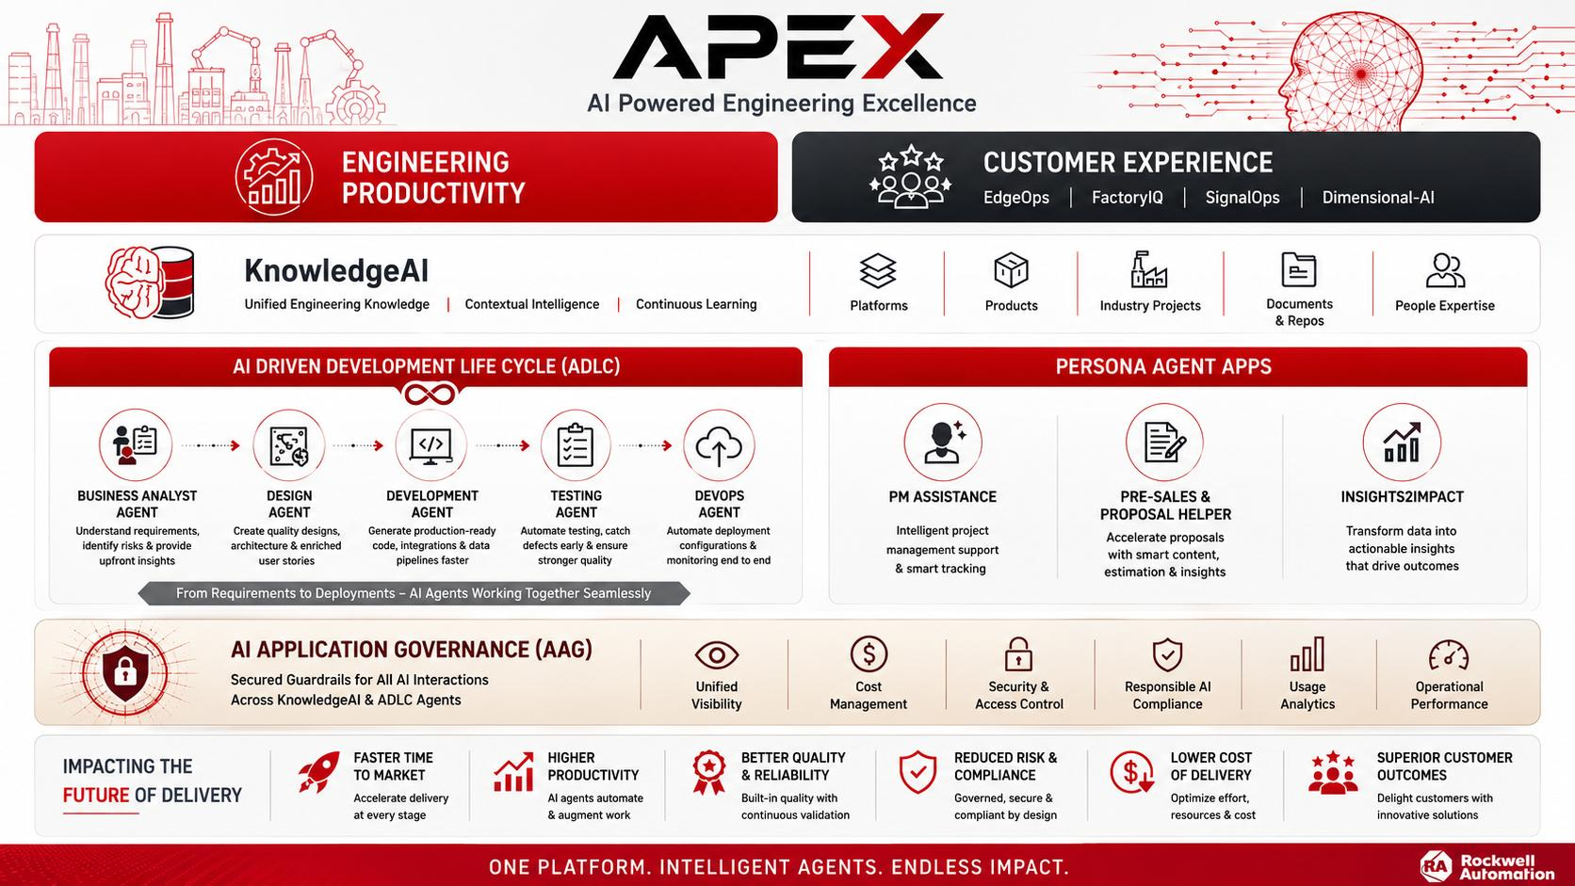

Slide 3
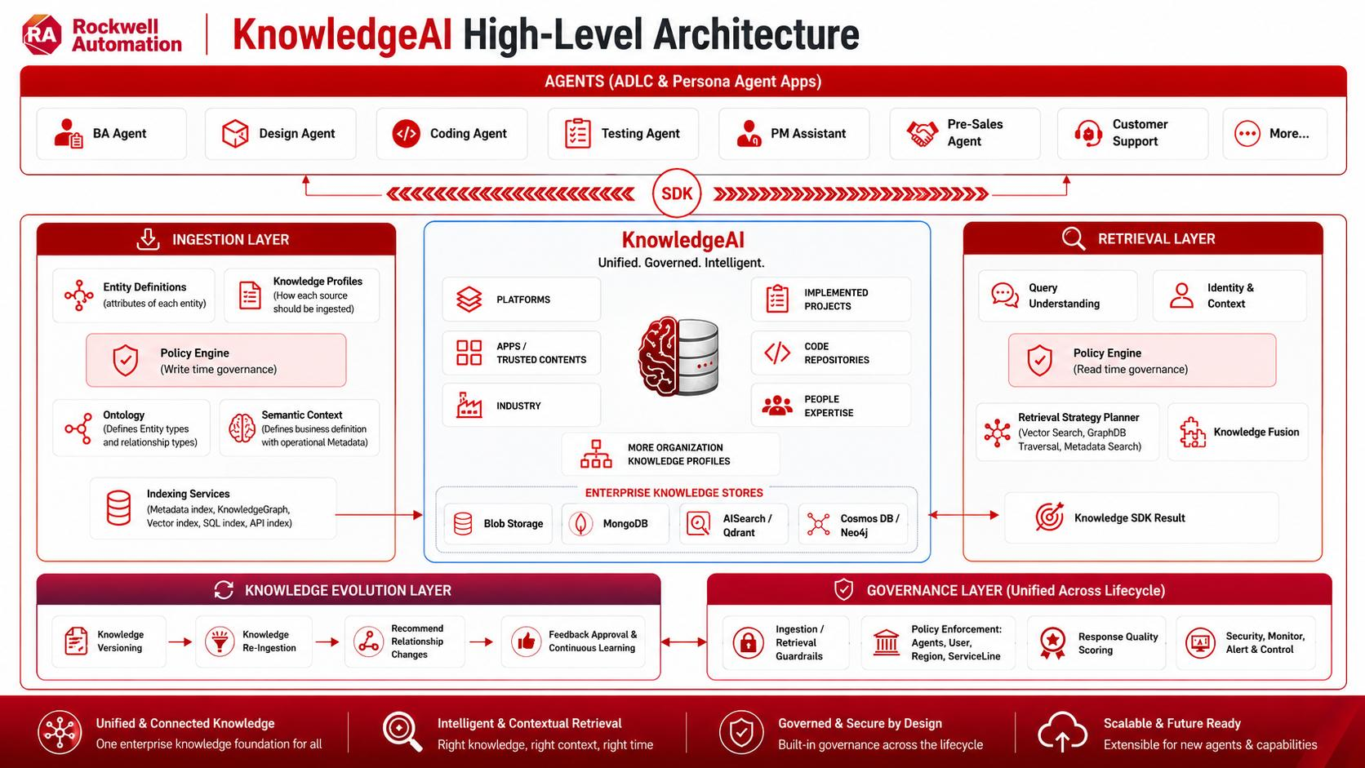
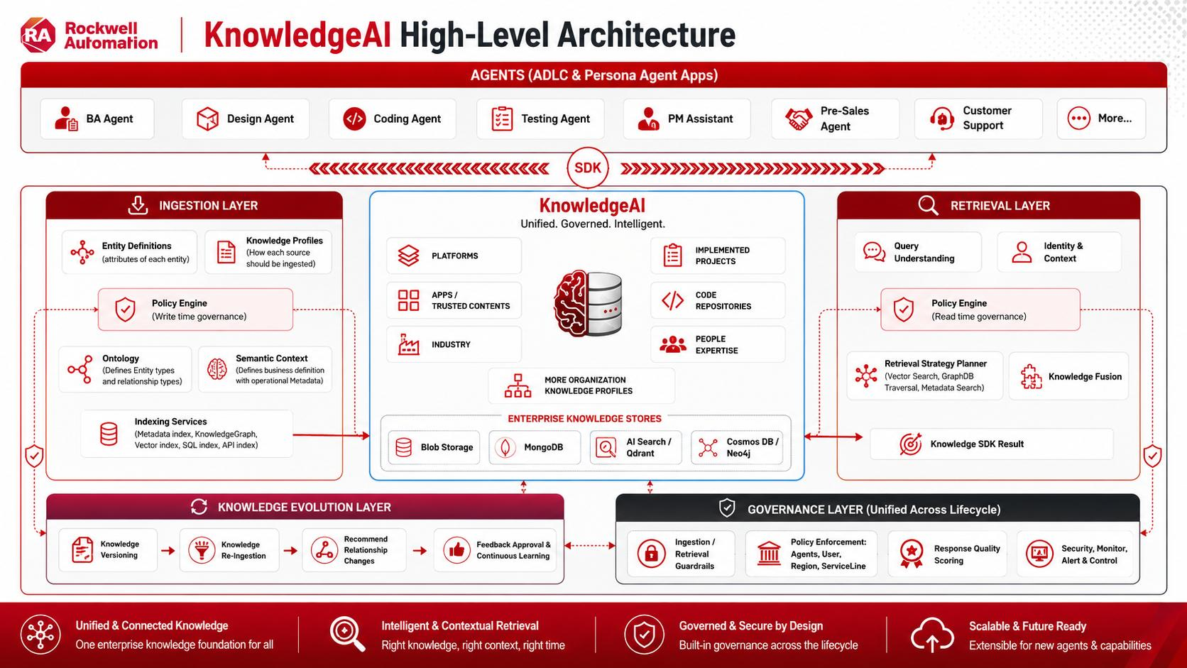
Notes:
KnowledgeAI: Unified Knowledge Intelligence Platform, it’s the enterprise brain of our organizational data where knowledges from various Knowledge Profiles such as Platforms, Apps/Trusted Contents, Implemented Projects, Sales, Customer Support etc. get extracted, curated, processed & ingested as AI contextualized data into KnowledgeAI Framework.
Architecture works with 5 important Layers:
1. Ingestion Layer: This layer is responsible to extract & process the knowledge from various sources and creates Ontology (Enterprise relationship), Entity linkages & Semantic contexts with Policy-Governed formation and convert it into vectors, graph, metadata and ingest into KnowledgeAI (MongoDb, AISearch etc.)
2. Integration Layer (SDK): KnowledgeAI provides a standardized SDK (Software Development Kit) using which, any Agents can connect with KnowledgeAI to retrieve processed and simplified organizational data in a standard, secured, authenticated way
3. Retrieval Layer: This layer eases the knowledge retrieval by narrow-down the search scope. When user asks a question in AI agent, agent calls SDK -> SDK initiates retrieval workflow in KnowledgeAI, through identifying the agent & user query intent & authorization, applies retrieval governance policy and traverse across from various knowledge profiles to retrieve most appropriate response back to SDK. Using the SDK result, AI Agents will execute its workflow to respond to the end user.
4. Knowledge Evolution Layer: This process takes part on both Ingestion layer as well as in Retrieval layer. When a new version of Platform knowledge gets ingested, this layer helps to automatically creates the linkages, maintains relationships to keep the knowledge structure intact. This works alongside with Governance Layer to improve the maturity of the response with human-in-loop for approval and update the knowledge as part of Continuous Learning.
5. Governance Layer: Governance spans the complete lifecycle, it takes part in Ingestion layer, Retrieval layer and also in Knowledge Evolution Layer. This detects protected data leakages, retrieval failures, missing relationships, obsolete knowledge and monitors usage, cost, performance by providing a Unified View.
Architecture Outcomes:
1. This architecture organizes, maps relationship & create linkages to the isolated knowledge and AI applications.
2. Every new AI Agent can immediately benefit from well linked and contextualized knowledge through KnowledgeAI framework
3. Governed way of knowledge update and feedback loop, ensures continuous learning of quality knowledge,
enabling AI Agents to remain organization relevant rather than generic and deliver near-accurate responses

Slide 4
Ingestion Layer Workflow
KnowledgeAI Profile Admin Creates New Knowledge Profile
Ontology Relation build between Profiles
Profile level Policy Guardrails
Knowledge Profile Created
Entity vs Attribute – AI Scoring
Independent Identity, Independent Lifecycle, Has Relationships, Has its own attributes, is it reused, Retrieval needs reason
Profile Admins Ingest Knowledge Source for Knowledge Profile
Transformed data stored internally
Blob storage etc
Entity & Attribute Discovery
Compares existing Entity
Admin
Modifies /
Qualifies
Knowledge
Entity Resolver
Canonical Entity / Synonyms, Aliases, Abbreviations, Renamed Concepts
Knowledge Model
Admin Modifies
Knowledge Evolution
Self learning based on repeated occurrence of missing relationships from multiple knowledge source
Ontology Relationship Builder
Uploaded source based actual entity linkage
Entity level policy (Optional)
Create Policies only for exceptional entities
Admin Publishes Knowledge Model with version
Admin Qualifies
Suggestions
Knowledge Model Schema
Starts Pipeline from Knowledge Source
Blob Storage
Embedding
Metadata Index
Knowledge Processing
Entity Mapper
Maps extracted content with Entity IDs from Knowledge Model
Relationship Builder
Create relationships between actuals as per Knowledge Model
Metadata Builder
Document, Entity, Knowledge Profile & Semantic Metadata
Knowledge Chunk Builder
Extractors
Processes the content from knowledge source
Indexing
Metadata -> Metadata Index
Entity & Relationships -> Knowledge Graph
Embeddings -> Vector DB
Knowledge Graph
Vector DB

Slide 5
Ingestion Layer Workflow
KnowledgeAI Profile Admin Creates New Knowledge Profile
Ontology Relation build between Profiles
Profile level Policy Guardrails
Knowledge Profile Created
New Profile
Entity & Attribute Discovery
Extracts Qualified Entity & Attributes
Profile Admins Ingest Knowledge Source for Knowledge Profile
Sharepoint folders, ADO, JIRA etc.
Transformed data stored internally
Blob storage etc
Profile
Validation
Entity vs Attribute – AI Scoring
Independent Identity, Independent Lifecycle, Has Relationships, Has its own attributes, is it reused, Retrieval needs reason
Admin
Modifies /
Qualifies
Knowledge
Entity Resolver
Canonical Entity / Synonyms, Aliases, Abbreviations, Renamed Concepts
Knowledge Model
Entity & Attribute Discovery
Compares existing Entity
Admin Modifies
Existing Profile
New/Modify Version
Knowledge Evolution
Self learning based on repeated occurrence of missing relationships from multiple knowledge source
Ontology Relationship Builder
Uploaded source based actual entity linkage
Entity level policy (Optional)
Create Policies only for exceptional entities
Admin Publishes Knowledge Model with version
Admin Qualifies
Suggestions
Knowledge Model Schema
Starts Pipeline from Knowledge Source
Blob Storage
Embedding
Metadata Index
Knowledge Processing
Entity Mapper
Maps extracted content with Entity IDs from Knowledge Model
Relationship Builder
Create relationships between actuals as per Knowledge Model
Metadata Builder
Document, Entity, Knowledge Profile & Semantic Metadata
Knowledge Chunk Builder
Extractors
Processes the content from knowledge source
Indexing
Metadata -> Metadata Index
Entity & Relationships -> Knowledge Graph
Embeddings -> Vector DB
Knowledge Graph
Vector DB

Slide 6
Retrieval Layer Workflow
Orchestrator
Query understanding
Retrieving relevant Entity with canonical maps & Relationship from Knowledge Model
Identity & Context
Identifying Who is asking, which Project, Platform version etc
Policy Engine – Read Time
Retrieval Profile – removes unauthorized content
Retrieval Strategy Planner
Choosing required stores to respond to the query
Ingestion
Layer
Knowledge Model Repository
Metadata
Index
Knowledge
Graph
Vector
DB
SDK
Integration Layer
Ranking & Re-ranking
Retrieved Source Scoring based on matches from Metadata, Graph, Profile, Version, Confidence score etc.
Response Packaging
Packaging based on Ontology from Knowledge Model
Knowledge Fusion
Combining the results retrieved from all the Knowledge stores
Agent

Slide 7
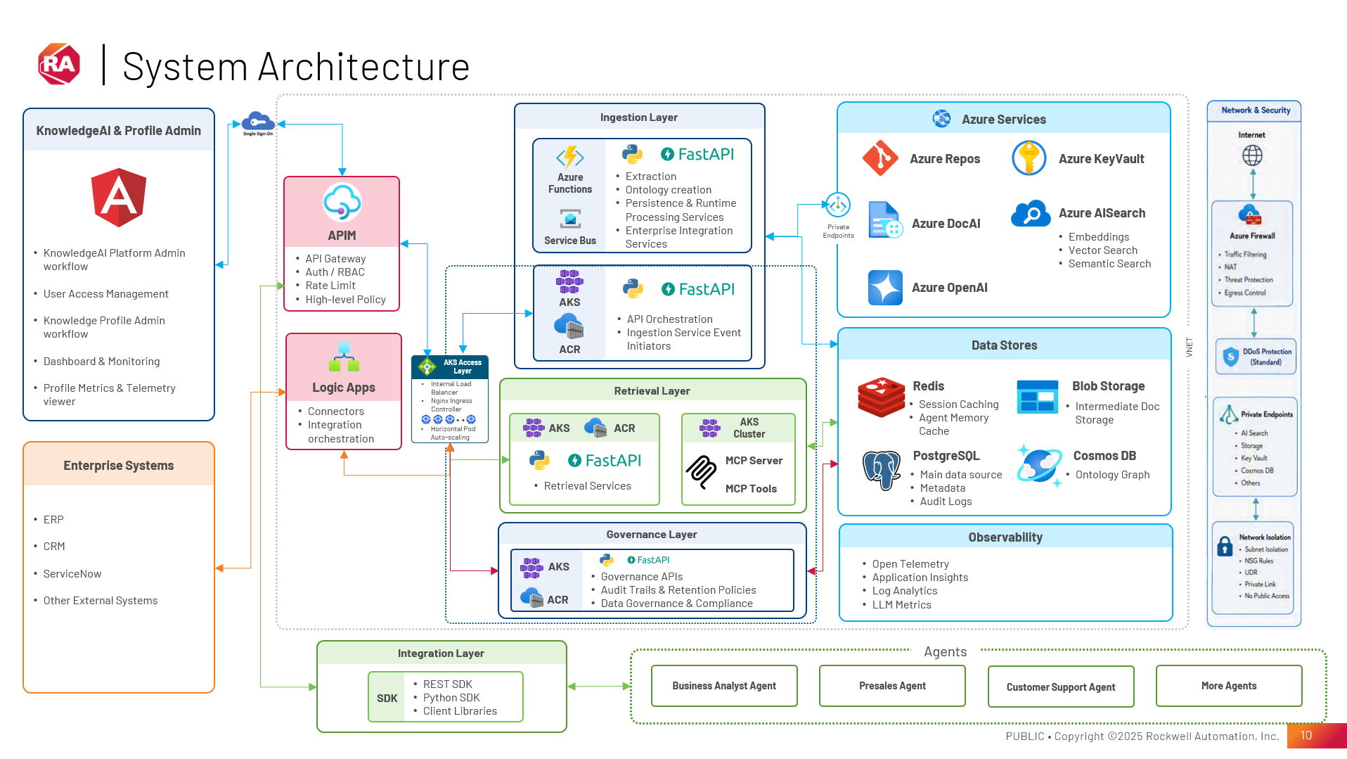

Slide 8
Challenges – Ingestion Layer
Knowledge Profile Model configuration complexity
Workflow for Continuous Ingestion – ADO Sync, GIT commits etc.
Entity Definition criteria / rule
Entity modification – how to modify ontology, graph, embeddings, metadata when some entity got deleted or modified
Ontology Explosion – how to control relationship edges. Relationship importance, confidence, frequency & lifetime to be identified
Metadata explosion – Every chunk will have metadata, how to normalize metadata
Versioning of all knowledge
Processing cost – impact on processing incremental knowledge
Graph consistency – Maintaining Graph confidence & provenance
Multi tenant Isolation – Isolation between different projects belongs to same Apps\
Ingestion Observability – Rejected Entities, Duplicate rate, Embedding Failures, Policy violations, Processing time, Graph growth, Chunk count, Confidence distribution

Slide 9
Ingestion Layer
Entity Definitions (attributes of each entity)
Knowledge Profiles
(How each source should be ingested)
Entity Resolver
(Avoids Duplications)
Relationship Builder
(Link Entities together)
Policy Engine
(Write time governance)
Indexing Services
(Metadata index, KnowledgeGraph, Vector index, SQL index, API index)
Ontology
(Defines Entity types and relationship types)
Extractors
(Convert source into entities)
Knowledge Profiles & Storage
Platforms
Apps
Industry
Implemented Projects
Code Repositories
Blob storage
SQL Db
MongoDb
Qdrant / AISearch
CosmosDb / Neo4j
Retrieval Layer
Identity & Context
Policy Engine
(Read time governance)
Retrieval Strategy Planner
(Vector Search, GraphDb Traversal, Metadata Search)
Knowledge Fusion
Ranking & Re-ranking
(Ranking factors)
Response Packaging
Knowledge SDK Result
(AI ready knowledge context)
Orchestrator / Query Understanding
Agents
SDK
User
Orchestration
(Intent -> Workflow -> Prompt)
Knowledge SDK Result
(AI ready knowledge context)
Agent Prompt Builder
LLM
Final User Response
Notes:
Ingestion Team
-
Retrieval Team
Agents

